Slide 1
Managing Impression

Slide 2

Appearance Management

Slide 3


Dress Your Part
Open culture company
Corporate company

Slide 4
Dress where it fits

Slide 5
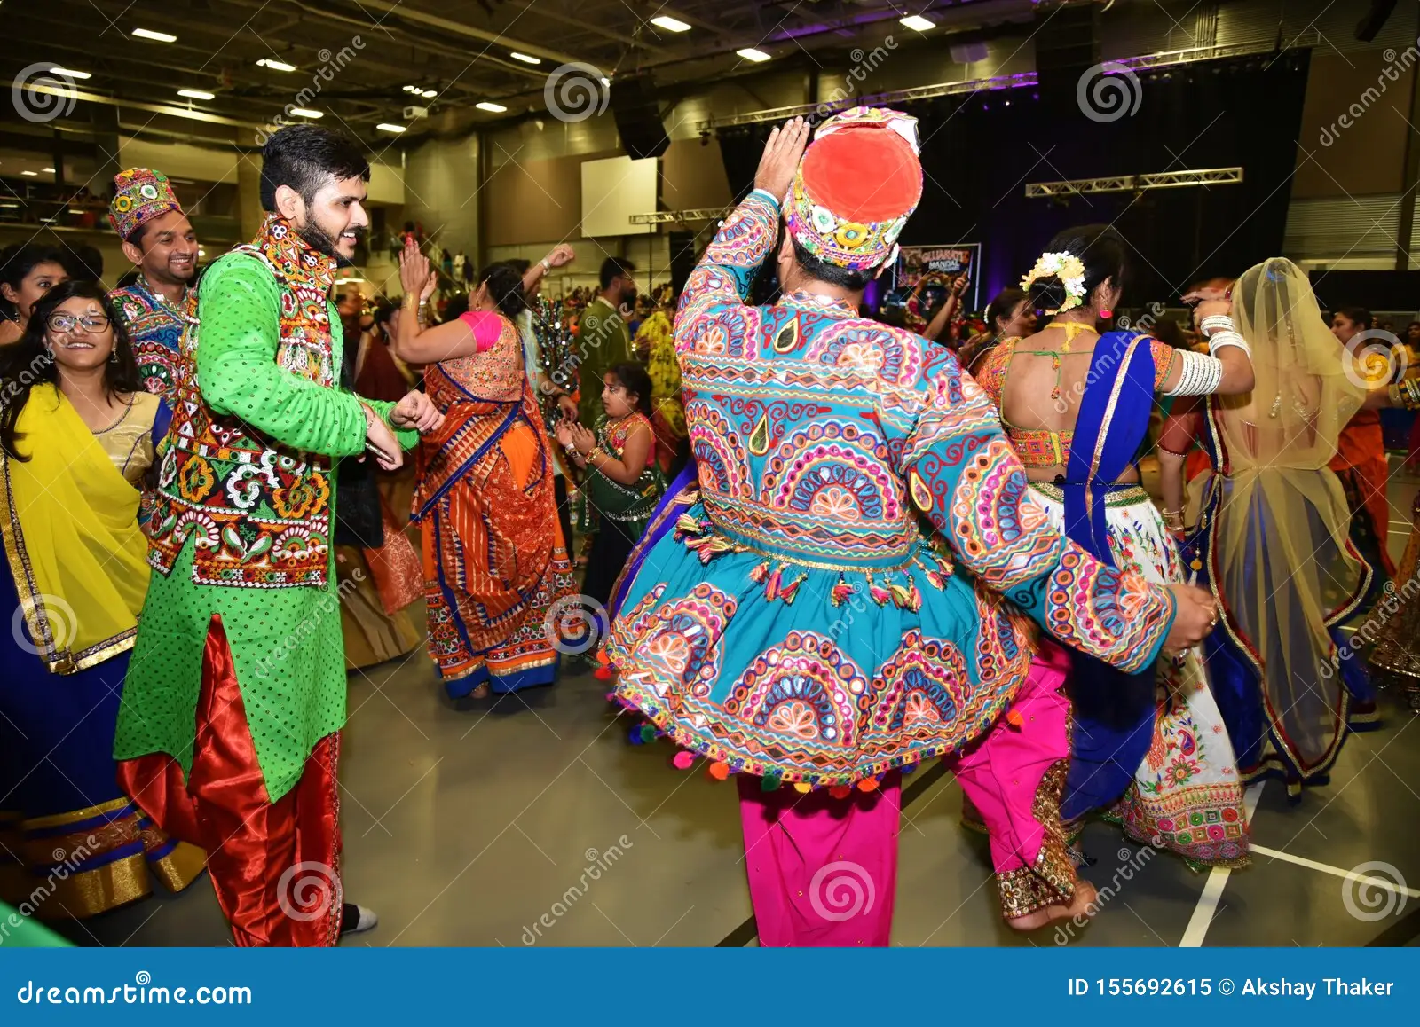

Slide 6
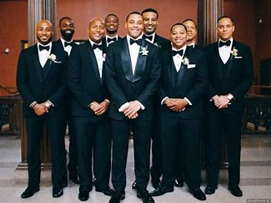
It creates good impression

Slide 7
It also create good impression in proper manner

